Slide 1
Additional Linear Algebra
CSCI 4150/6050: Computer Vision

Slide 2

Vectors
Direction
Magnitude
(length)

Slide 3
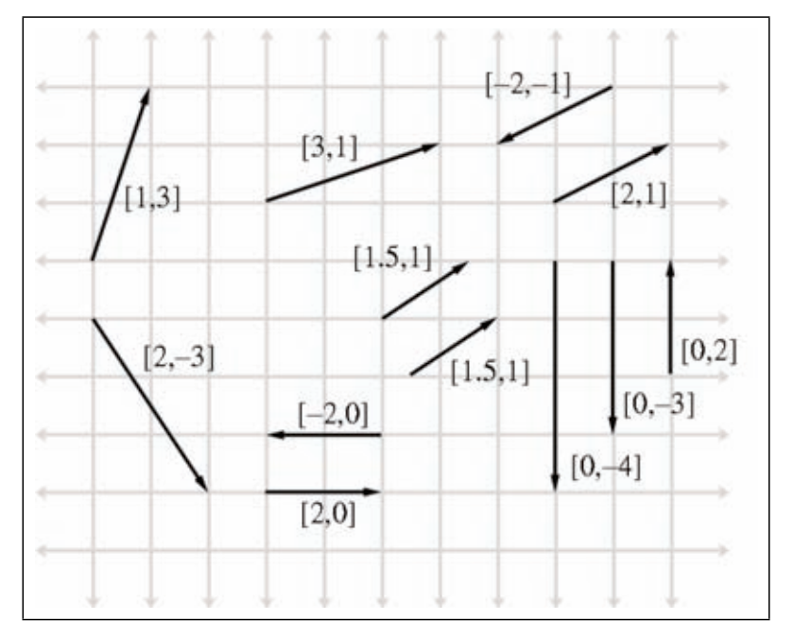
Vectors as Displacements
Head
Tail

Slide 4
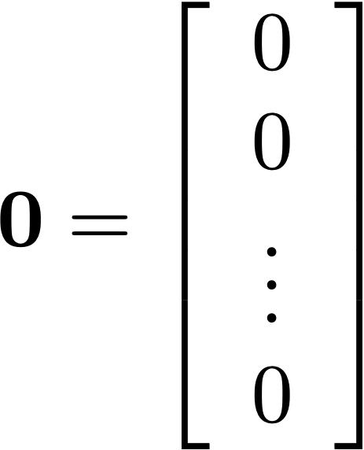
Zero Vector
The zero vector is all zeroes
No displacement
Magnitude is 0
Direction is undefined

Slide 5
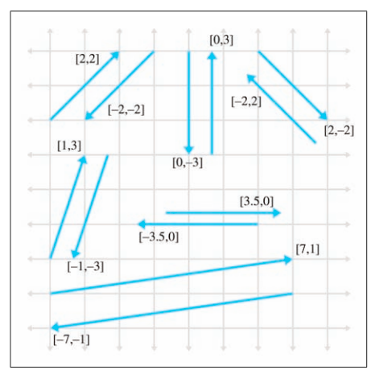
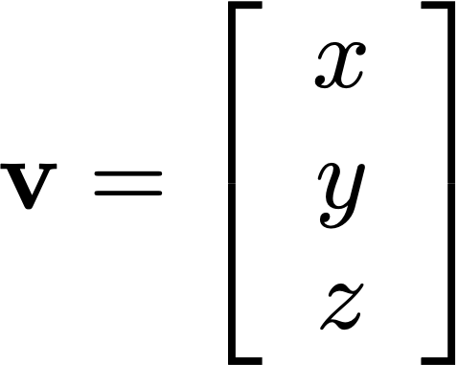
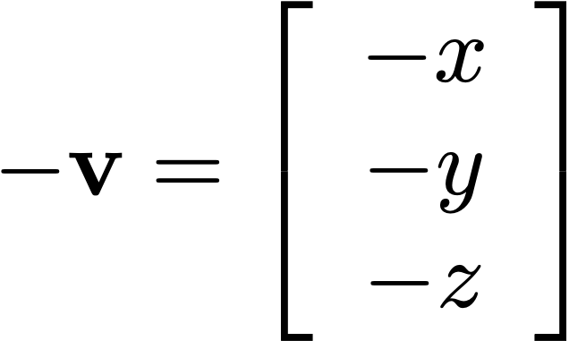
Negating Vectors
The negative of a vector has the same magnitude
in the opposite direction

Slide 6
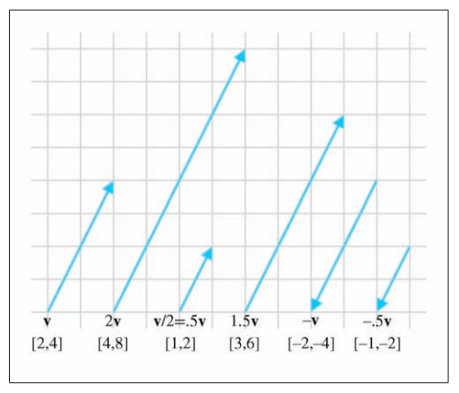
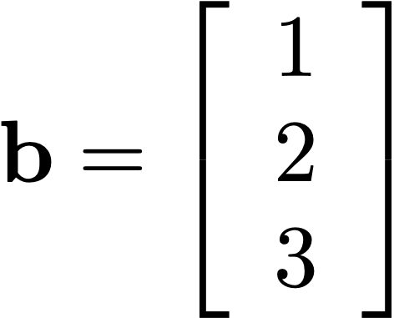
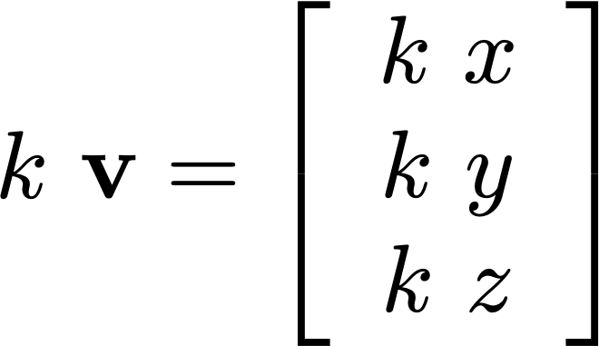
Scaling Vectors
Multiplying by a constant multiplies each element
-- multiplies magnitude, same (or opposite) direction

Slide 7
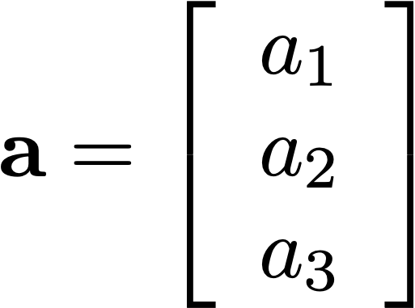
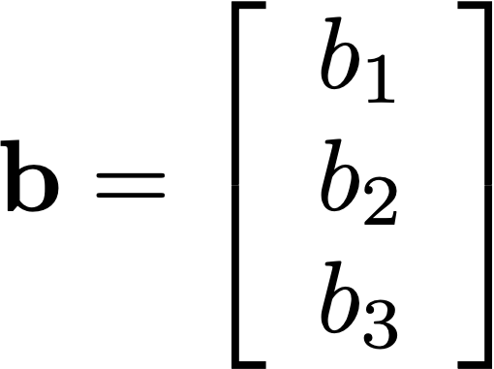
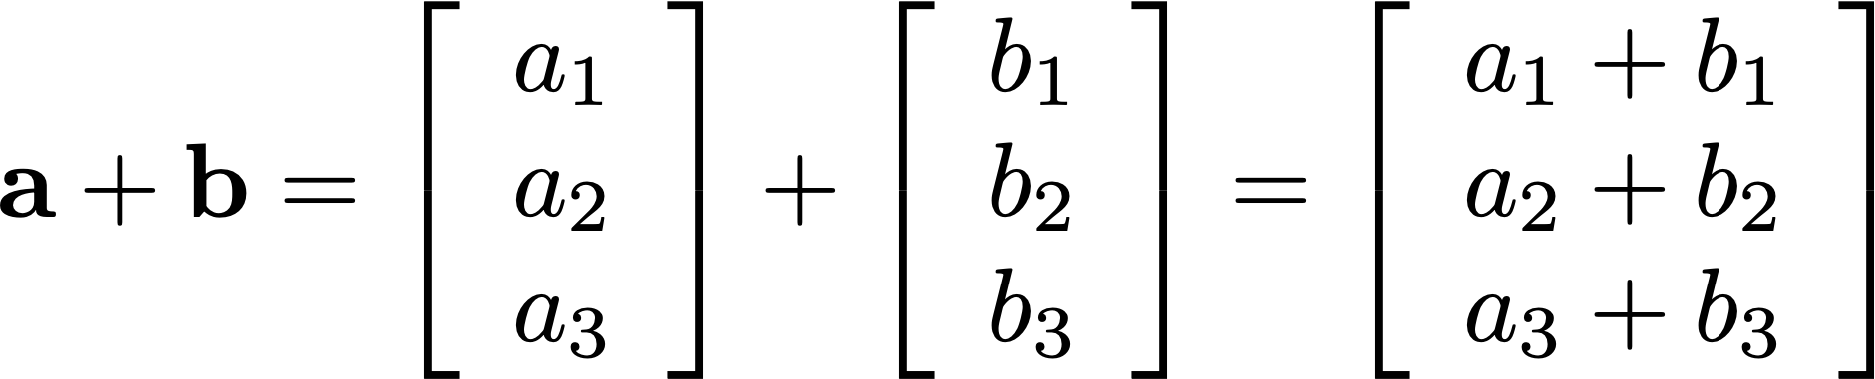
Adding Vectors
Point-wise add the elements

Slide 8
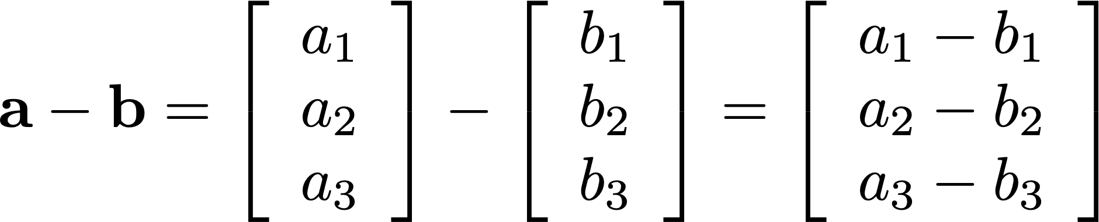
Subtracting Vectors
Point-wise subtract the elements

Slide 9
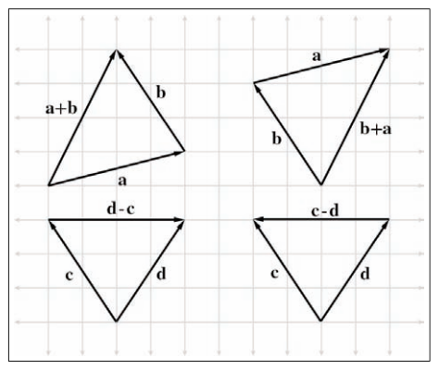
Geometric Interpretation
“Go this way, then go that way”

Slide 10
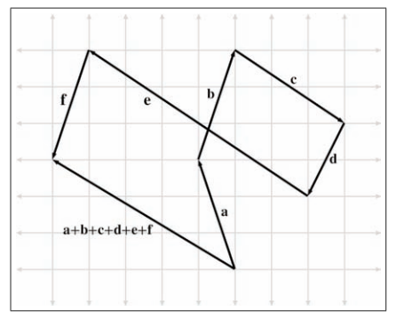
Geometric Interpretation

Slide 11
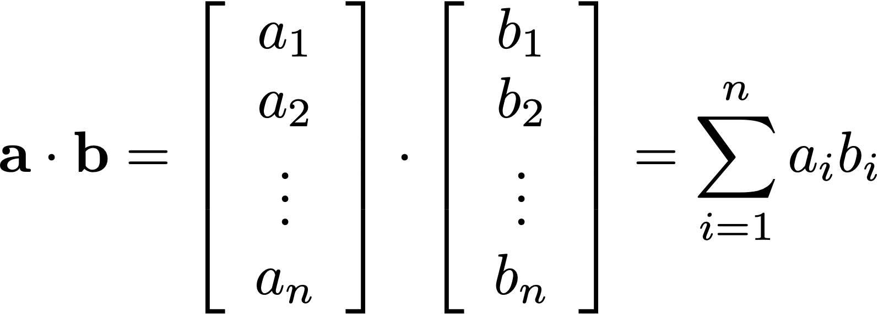
Vector Dot Products
One of the most commonly used
vector operations in graphics

Slide 12
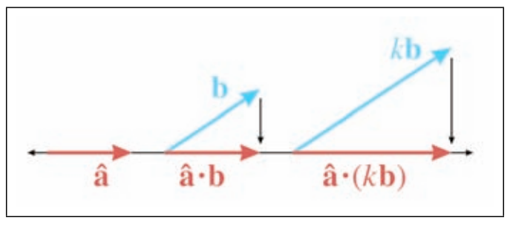
Scalar Multiplication

Slide 13
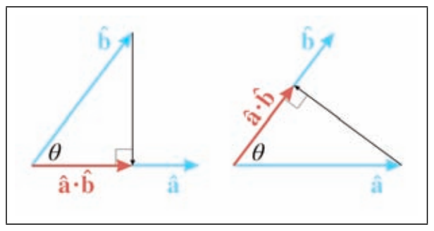

Commutative

Slide 14
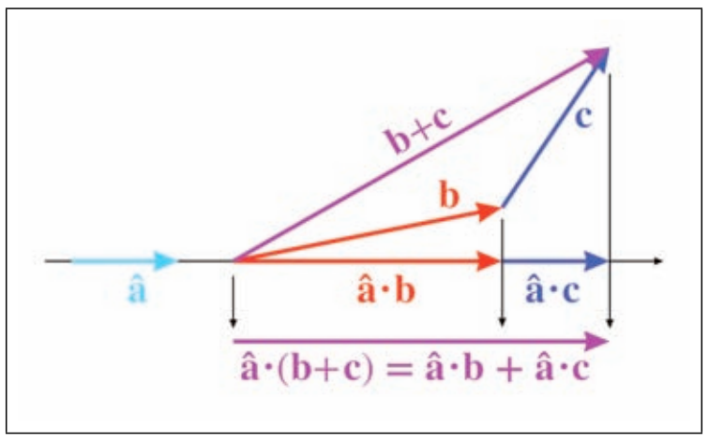
Distributes Over Addition

Slide 15
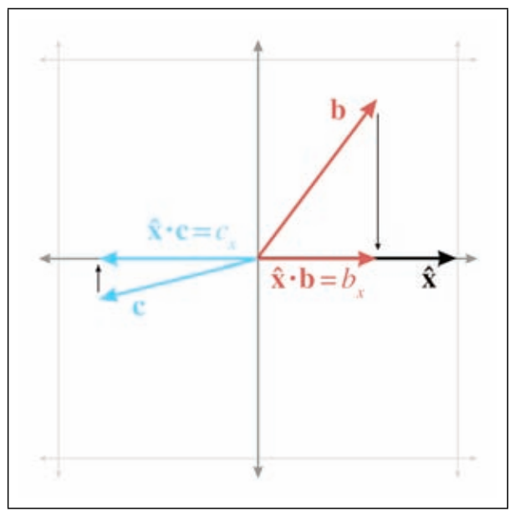
Coordinates
To get coordinates, just project onto the axis directions
Really useful property that we’ll come back to

Slide 16
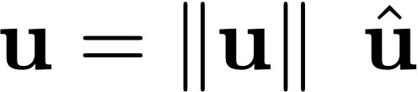
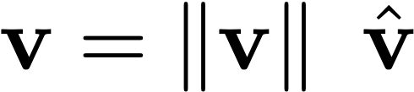
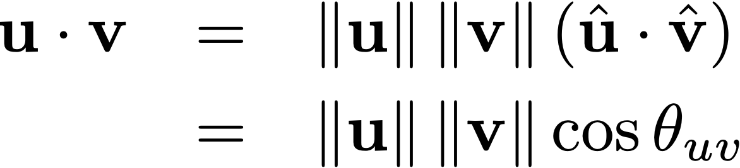
Angles
The dot product of two vectors is the product of their lengths times the cosine of the angle between them

Slide 17
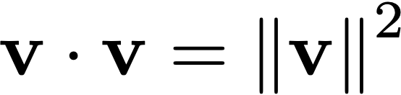
Lengths
The dot product of something with itself
is its own length squared
Tip: lots of “distance” tests only need squared distance

Slide 18
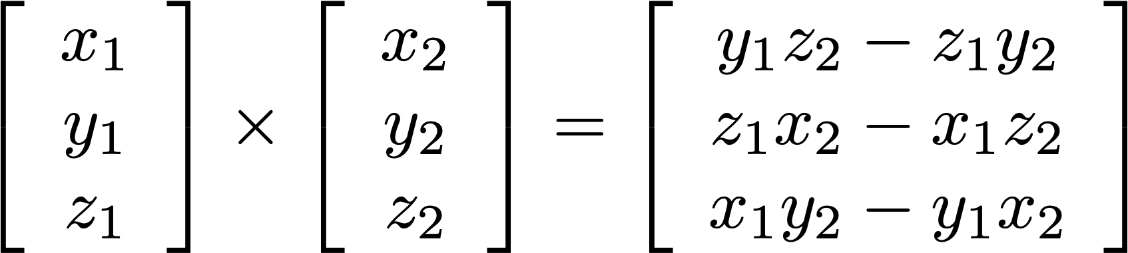
Cross Product
Result is a vector
Only done in 3D

Slide 19
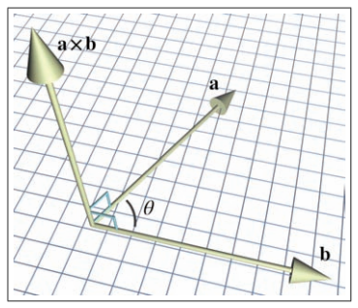
Geometric Interpretation
The cross product of two vectors is
another vector orthogonal to the two
(really useful property in 3D geometry!)

Slide 20
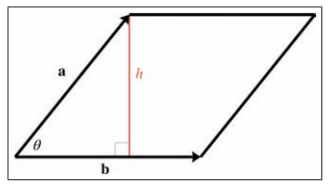
Geometric Interpretation
The length of the cross product of two vectors
is the area of the parallelogram spanned by the two

Slide 21
Geometric Interpretation

Slide 22
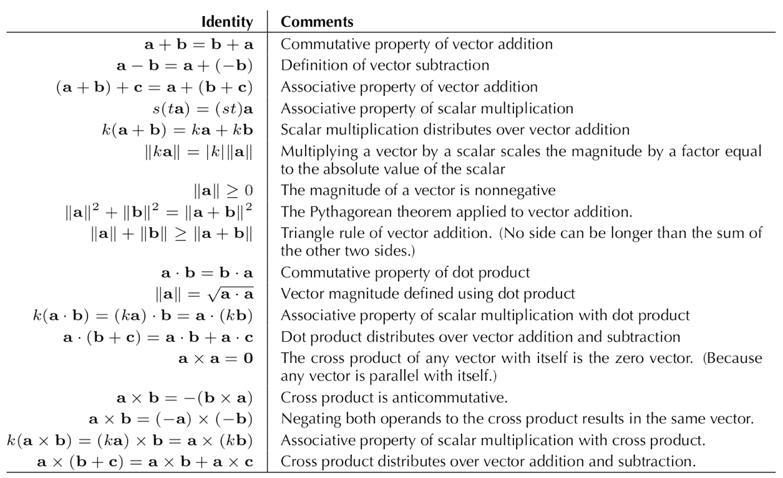
Linear Algebra Identities

Slide 23
A little more on matrices

Slide 24
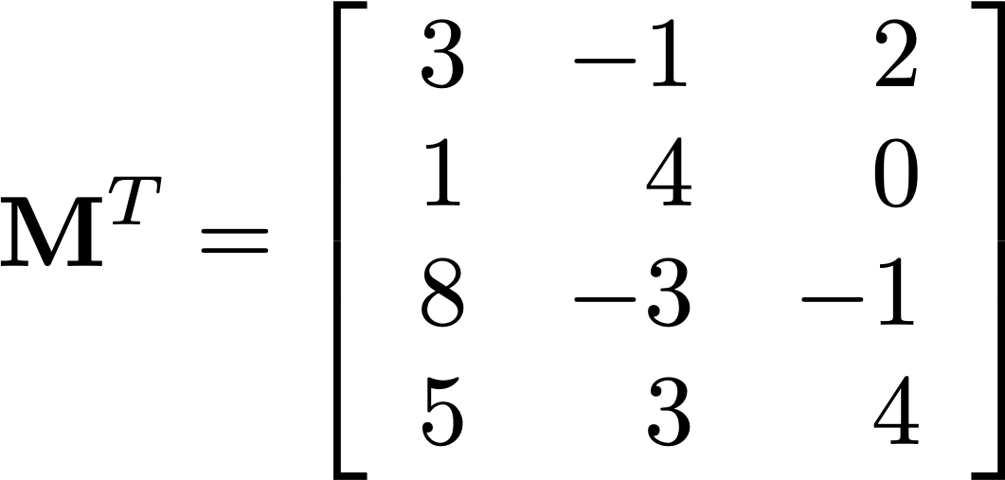
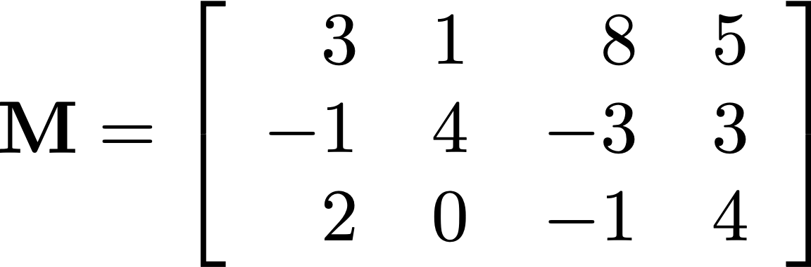
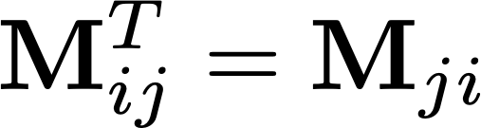
Transposing
“M transpose”
The transposition of a matrix simply swaps
the rows for the columns

Slide 25
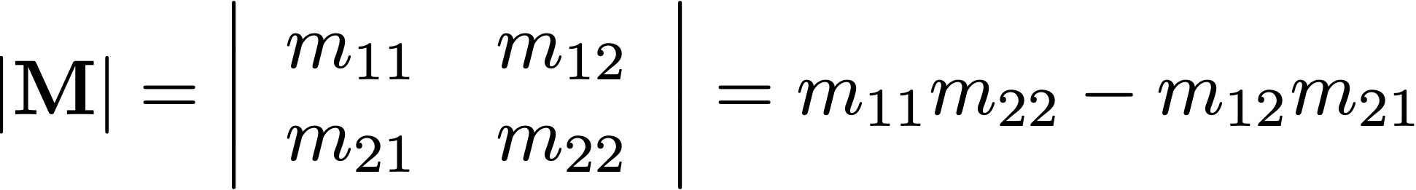
Determinant

Slide 26
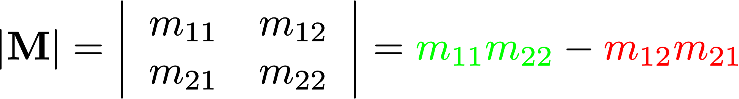
Determinant

Slide 27
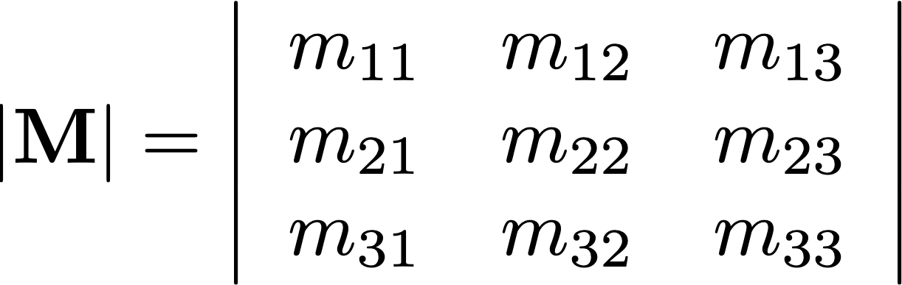
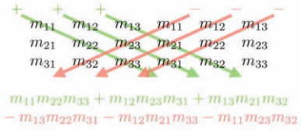
Determinant

Slide 28
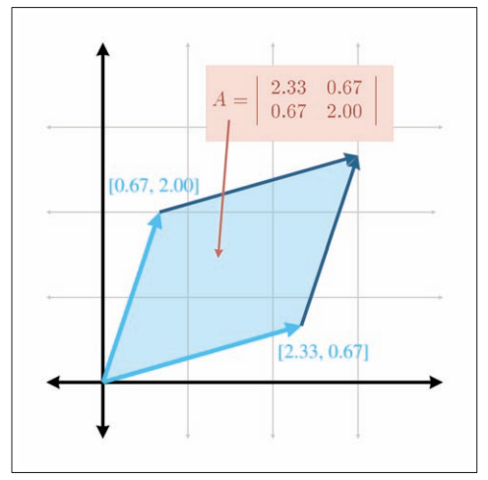
Geometric Interpretation

Slide 29
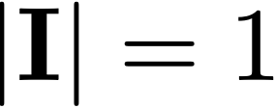


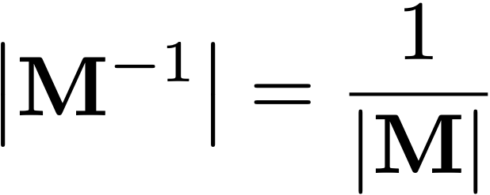
Properties of Determinants

Slide 30
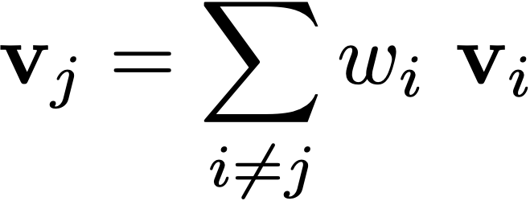
Linear Independence
A set of vectors is said to be linearly dependent
if at least one of them can be expressed as a
linear combination (weighted sum) of the others:
If not linearly dependent, then linearly independent

Slide 31
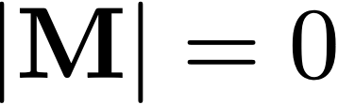
Singular Matrices
But what if ?
A matrix whose determinant is zero
has no inverse and is said to be singular

Slide 32
Singular Matrices
What does a singular matrix mean geometrically?
The rows are linearly dependent
“Flattens” the space

Slide 33
Matrix Rank
The rank of a matrix is the number of linearly independent rows
When used as transforms, matrices with full rank transform to
the full space
Singular matrices have insufficient rank and collapse to a corresponding subspace
Geometric interpretation: the rank of a matrix is the dimensionality of the (sub)space that matrix maps to

Slide 34
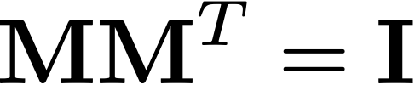
Orthogonal Matrices
Two (square) matrices are said to be orthogonal iff
Implies rows are orthonormal vectors

Slide 35
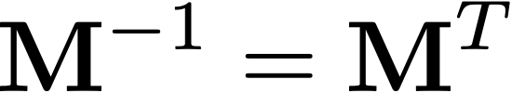
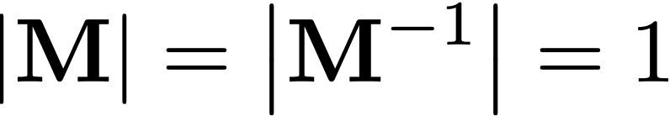
Orthogonal Matrices
Orthogonal matrices are also easily invertible:
Implies

Slide 36
Orthogonal Matrices
All rotation matrices are orthogonal
All orthogonal matrices are rotations!
AND

